Slide 1
Title: Predict Housing Prices
Author: Reema Jain

Slide 2
Introduction
Problem Statement:
Predict the sale price of a house based on data about other similar houses & create an effective price prediction model
Problem Solving Framework:
Importing data & necessary libraries
Understanding & exploring the data
Data cleaning
Finding correlation
Creating and analyzing Linear Regression Model
Checking validity of price prediction model against test data

Slide 3
The Data
Data Description:
SalePrice: Property's sale price in dollars. This is the target variable we are trying to predict
LotArea: Lot size in square feet
OverallQual: Rates the overall material and finish of the house
YearBuilt: Original construction date
YearRemodAdd: Remodel date (same as construction date if no remodeling or additions)
MasVnrArea: Masonry veneer area in square feet
TotalBsmtSF: Total square feet of basement area
1stFlrSF: First Floor square feet
GrLivArea: Above grade (ground) living area square feet
FullBath: Full bathrooms above grade
TotRmsAbvGrd: Total rooms above grade (does not include bathrooms)
GarageYrBlt: Year garage was built
GarageCars: Size of garage in car capacity
GarageArea: Size of garage in square feet

Slide 4
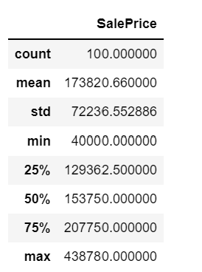
The Data
Data has 100 rows & 82 columns
Below are the statistics & histogram about target variable ‘Y’ i.e. Sale Price:

Slide 5
Data Exploration
First Assumption: Houses with higher 'all living area in square feet' will have
higher ‘sales price’
Scatter Plot:
Interpretation:
Above graph displays strong positive relationship between GrLivArea & SalePrice

Slide 6
Data Exploration
Second Assumption: Houses with higher 'total square feet of basement area' will sell for higher price.
Scatter Plot:
Interpretation:
Above graph displays strong positive relationship between TotalBsmtSF & SalePrice.
As TotalBsmtSF increases, SalePrice also increases.

Slide 7
Data Exploration
Third Assumption: Houses with higher rates for 'overall material and finish of the house' will sold for higher price.
Scatter Plot:
Interpretation:
Above graph displays very strong positive relationship between OverallQual & SalePrice

Slide 8
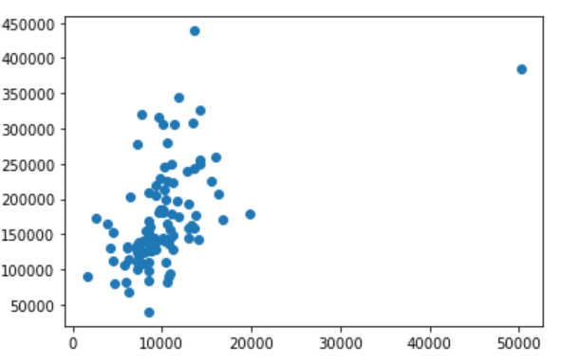
Data Exploration
Fourth Assumption: Houses with higher lot area will have higher sale price.
Scatter Plot:
Interpretation:
Above graph shows that LotArea & SalePrice are not significantly correlated. It seems like sale price is concentrated around 10000 lot area.

Slide 9
Data Exploration
Fifth Assumption: Houses built later on will have newer features & better layout and, hence, will have higher sale price.
Scatter Plot:
Interpretation:
Above graph displays strong positive relationship between YearBuilt & SalePrice.
Newer the house, higher will be sale price.

Slide 10
Data Exploration
Sixth Assumption: I assume Garage built in recent years will have better layout and, hence, will have higher sale price.
Scatter Plot:
Interpretation:
Above graph shows there is strong positive correlation between SalePrice & GarageYrBlt. Newer the garage, higher will be sale price.

Slide 11
Data Preparation
Below steps were taken to clean & reshape the data:
Computed columns with numeric values & checked if these columns contain Null values
Decided whether to replace, interpolate or remove Null Values from columns
Replaced GarageYrBlt null values with col YearBuilt values
Used interpolate & dropna function to clean other columns

Slide 12
Correlation
Below is the correlation factor for different variable with respect to Sale Price:

Slide 13
Project Description
Linear Regression can be used to predict value of dependent variable (i.e. Y) based on one or more independent variables(i.e. X).
Multiple Linear Regression Equation is given by:
Y=X1β1 + X2β2 + X3β3...
Where Y(dependent variable), X1/X2/X3 are independent variables, β1,β2,β3 are betas
Algorithm used to predict Y based on X independent variables:

Slide 14
Project Description
Continued…
Validate effectiveness of model using below:
1. R²(The coefficient of determination)
2. Visualize Residual plots using Histogram
3. Visualize Scatter plots for predicted vs actual values of target variable

Slide 15
Analysis and Results
Created Price prediction model for three group of variables.
First Group:
Selected variables with correlation of 69% or more with Sale Price.
Variables: Below are the 3 variables:
Result:
R² is 79% which shows 79% of the variability in the target variable(i.e. Y) is explained by above independent variables
Histogram of error depicts normal distribution around 0
Scatter plot for predicted vs actual value of Y form a straight line

Slide 16
Analysis and Results
Second Group:
Selected variables with correlation of 60% or more with Sale Price.
Variables: Below are the 7 variables:
Result:
R² is 85% showing 85% of the variability in the target variable(i.e. Y) is explained by above independent variables
Histogram of error depicts normal distribution around 0
Scatter plot for predicted vs actual value of Y form a straight line

Slide 17
Analysis and Results
Third Group:
Selected variables with correlation of 50% or more with Sale Price.
Variables: Below are the 13 variables:

Slide 18
Analysis and Results
Continued…
Result:
R² of 88% depicts 88% of the variability in the target variable(i.e. Y) is explained by above independent variables.
Histogram of error depicts normal distribution around 0
Scatter plot for predicted vs actual value of Y form a straight line
As per R², effectiveness of our models improved from 79% (1st set of variables) to 85%( 2nd set of variables) & further to 88%(3rd set of variables)

Slide 19
Verification
Verified third model against Test Data.
Result:
R² is 84% on test data versus 88% on actual data
Histogram of residuals depicts normal distribution around 0
Scatter plot for predicted vs actual value of Y form a straight line
Observations:
R² went down from 88% to 84% when verifying the model against test data
Model still holds good at 84% as 84% of the variance in the target variable(i.e. Y) is still explained by selected independent variables from actual data

Slide 20
Conclusion
Linear Regression comes handy when predicting value of dependent variable from multiple independent variables. It assess the impact of different independent variables on the outcome.
Model predicted just 88% of the variability in the target variable. This shows model is not perfect and can further be improved.
Current model doesn’t take into consideration categorical data which can impact the results.
Effectiveness of model improves when more independent variables with higher correlation are added to the analysis.

Slide 21
References
Websites:
“Regression analysis” Wikipedia. 8/27/2022 https://en.wikipedia.org/wiki/Regression_analysis.
“Residual Plot Analysis” OriginLab. 8/27/2022 https://www.originlab.com/doc/Origin-Help/Residual-Plot-Analysis
*Please add slides as required.

